Slide 1

IoT based Healthcare Kit
Group No. 23
Shreya Bhutada 17104019
Purvika Gaikar 15104027
Akshata Singh 17104033
Project Guide : Prof. Kaushiki Upadhyaya

Slide 2
Contents
Introduction
Objectives
Problem Definition
Technological Stack
Review Suggestions
Proposed System Architecture/Working
Prototype Design Demonstration
Plan of Paper Publication

Slide 3
Introduction
A portable, low cost, light weighted, low power electronic health care system device is proposed to record and monitor health parameters.
This system facilitates continuous real time analysis of various patient parameters such as ECG, heart rate and temperature by using various sensors respectively and the collected data is sent to the cloud using IoT.
In addition to this, Healthbot is being developed which intends to provide a personalized health and therapy information to patients as well as suggest basic healthcare tips based on patient symptoms.

Slide 4
Objective
The objective is to develop an absolute, portable and cheap system which incorporates Arduino that will be 24/7 available.
It will help the disabled and old people who cannot come to hospitals independently for their regular checkups.
The healthcare system can enable constant monitoring of a patient through checking various parameters such as temperature, blood pressure and heart rate.
It provides with real-time medical information about a patient via IoT and processes the information gathered about the patient.
In addition to this, the chatbot will assists medical queries, symptom check, provide referral for major issues and will try to analyze the cause of illness according to the information given by the patient and provide adequate health care tips for the identified issue.
With such feasibility of chatbot, it will help decrease time and expenditure of patients.

Slide 5
Problem Definition
Many rural areas don’t have enough physicians, hospitals and other health care resources to provide quality care for the whole population.
Long waiting times, long duration between visits and a wide range of other challenges can prevent health care professional from providing the best care possible.
In addition to this, there are applications which are just limited to making appointments with doctors and very minimal interaction related to disease condition of the patients.
This project aims at providing an Iot based remote Health care kit and AI Chatbot which provides healthcare tips to patients, and effectively, reducing the cost of customer service and providing a vital communication link between doctors and patients

Slide 6
Technological Stack
Hardware :
ECG monitor sensor module
Glucometer
Temperature Sensor
Blood pressure sensor
Arduino UNO
Display
Software :
Python 3.7

Slide 7
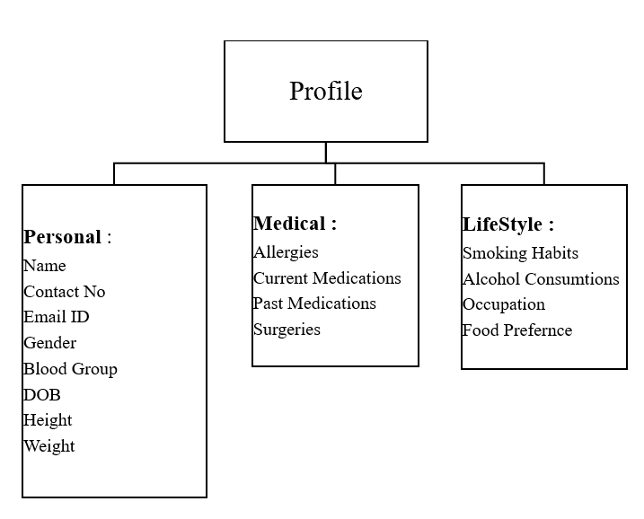
Proposed System Architecture/Working
Registration

Slide 8
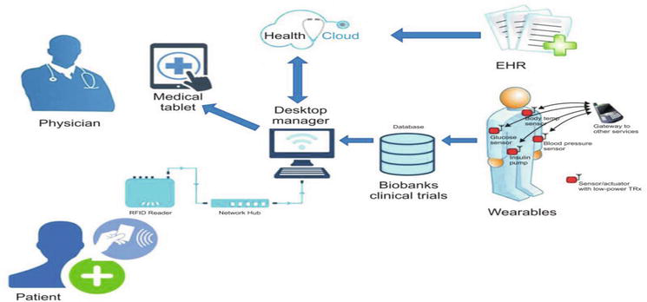
Proposed System Architecture/Working
Health bot

Slide 9
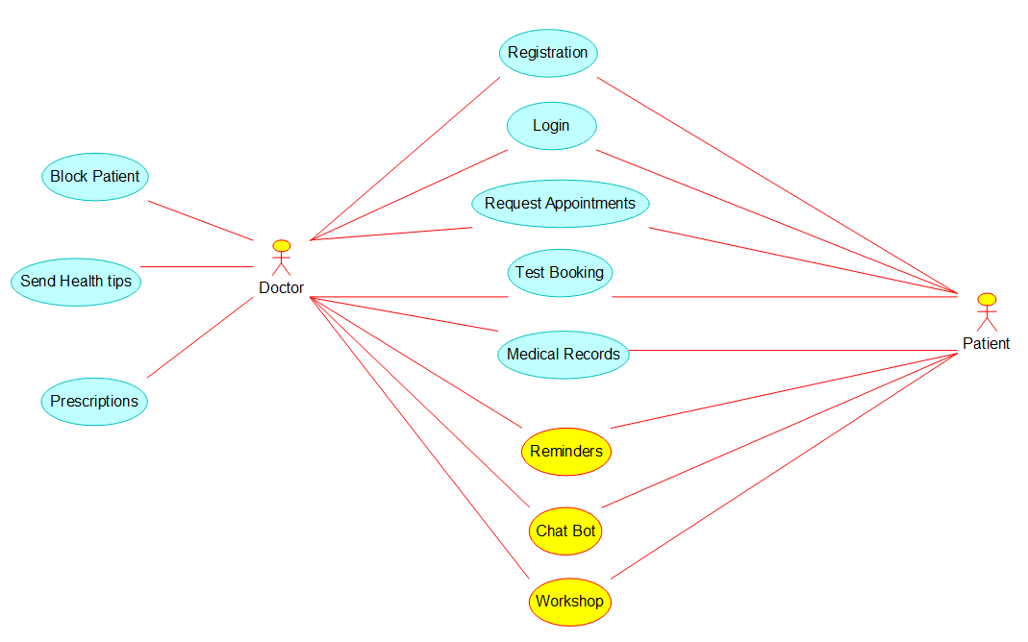
Health Bot – Use case diagram

Slide 10
Features
Search for Doctor
Appointments
Test Bookings
Gynaecology
Dermatology
General physician
Psychiatry
Pediatrics
Sexology
Diet and Nutrition
Dentist
Pediatric Dentist
Morning(10 Slots)
Afternoon(10 Slots)
Evening(10 Slots)
Night(5 Slots)
Book and Add tests
Select Labatory (location)
Select a Time slot

Slide 11
Reminder
Consultations
Medical Records
Title
Medicine
Timings
Ask a Question
Problem Type
Description
Select a profile
Photo
Document
Text
Files

Slide 12
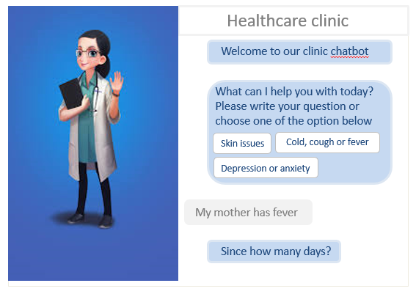
Prototype Design Demonstration
Healthbot Prototype

Slide 13
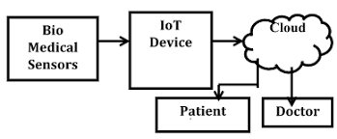
Prototype Design Demonstration
IoT based health kit

Slide 14
Plan of paper publication
We are planning to present a paper in IEEE 2021 6th international conference for convergence in technology. The full paper deadline for this conference is 15 November 2020.

Slide 15
Thank You...!!

